Slide 1
COMBINATIONAL
LOGIC
Part I
Chapter - 7
Fall 19
M. E. Zaghloul
M.E.Zaghloul

Slide 2
Combinational Circuits
Output at any instant of time is function of the current input
No storage
Styles of CMOS implementation is the topic of this class
Chapter 6 in the text
M.E.Zaghloul

Slide 3
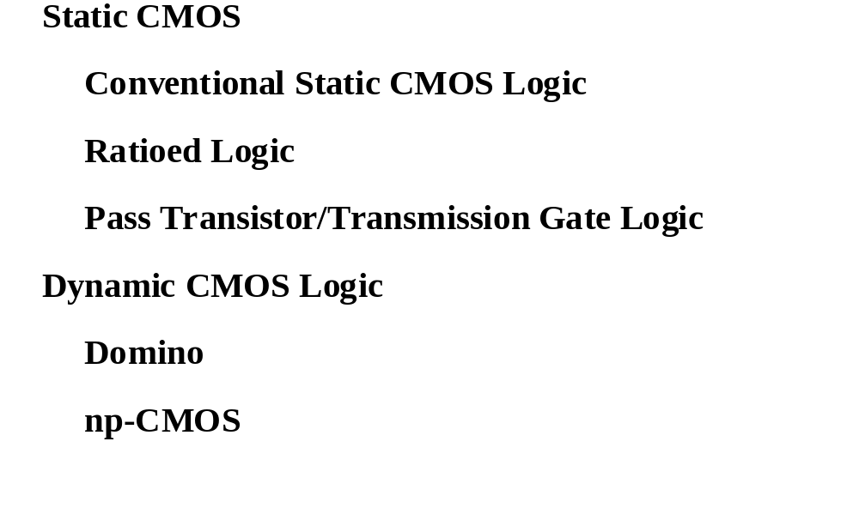
Overview
Logic Families in CMOS
Part I
Part II
M.E.Zaghloul

Slide 4
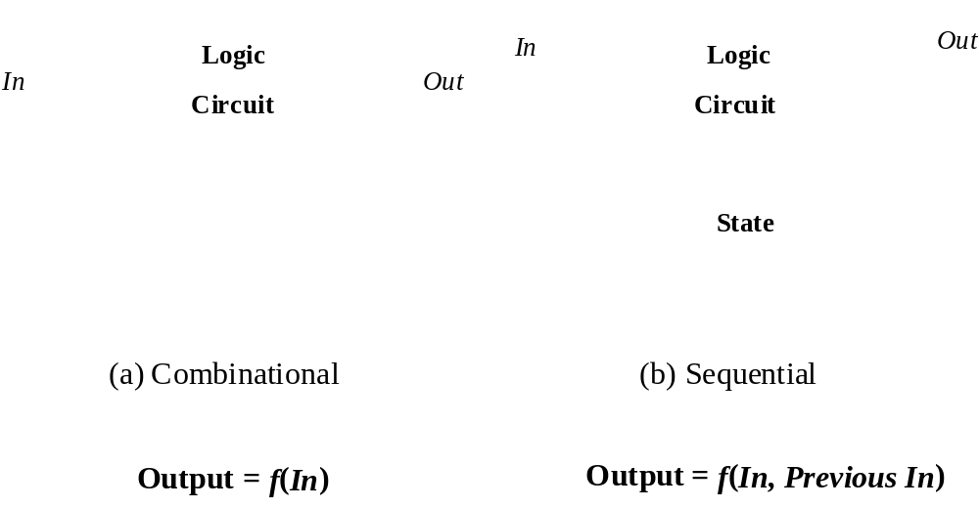
Combinational vs. Sequential Logic
M.E.Zaghloul

Slide 5
Static CMOS Circuit
At every point in time (except during the switching
transients) each gate output is connected to either
V
or
V
via a low-resistive path.
DD
ss
The outputs of the gates assume at all times the value
of the Boolean function, implemented by the circuit
(ignoring, once again, the transient effects during
switching periods).
This is in contrast to the
dynamic
circuit class, which
relies on temporary storage of signal values on the
capacitance of high impedance circuit nodes.
M.E.Zaghloul

Slide 6
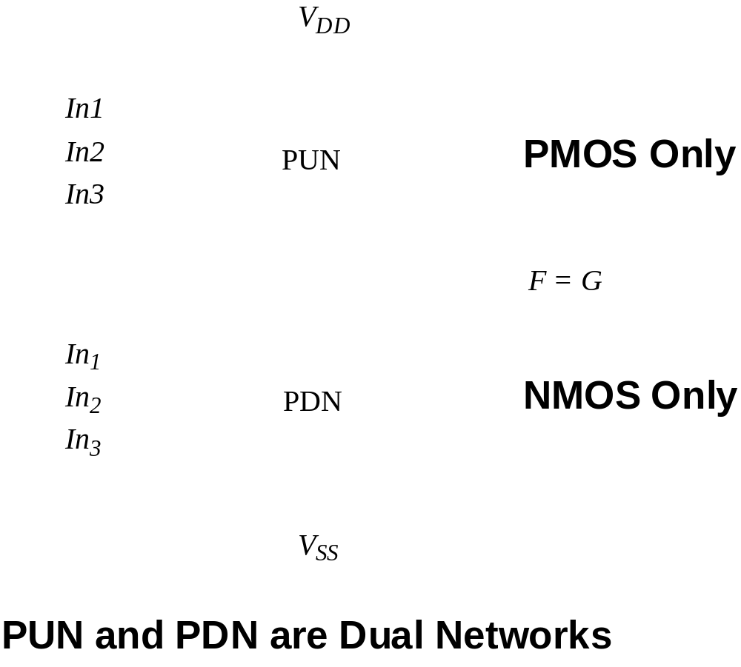
Static CMOS
M.E.Zaghloul

Slide 7
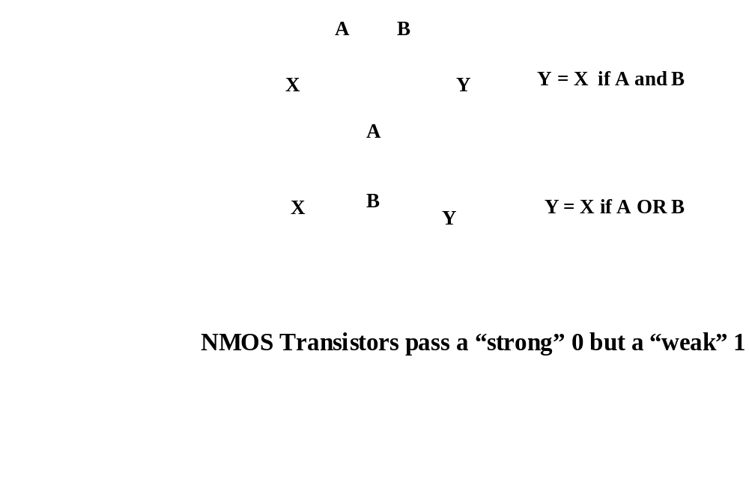
NMOS Transistors in Series/Parallel Connection
    Transistors can be thought as a switch controlled by its gate signal
    NMOS switch closes when switch control input is high
M.E.Zaghloul

Slide 8
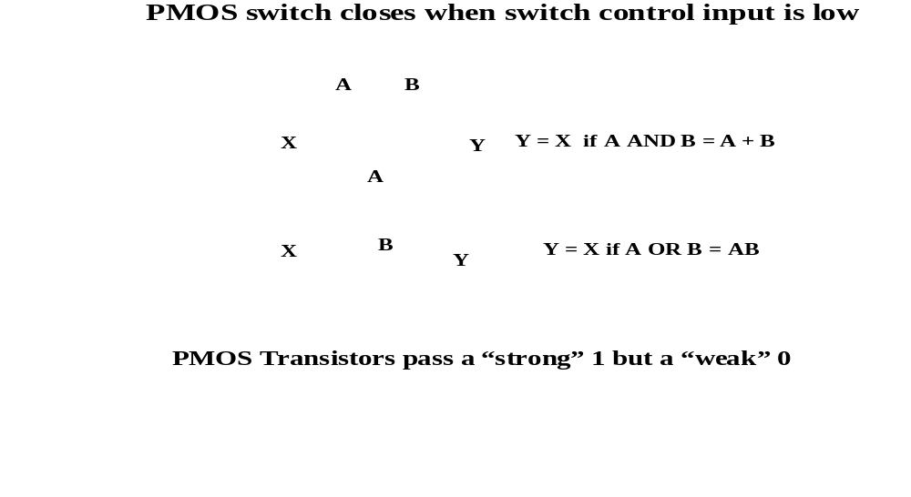
PMOS Transistors in Series/Parallel Connection
M.E.Zaghloul

Slide 9
Threshold Drops
V_{DD}
V_{DD}
PUN
S
D
V_{DD}
D
0----V_{DD}
S
0 --- V_{DD} - V_{Tn}
V_{GS}
C_{L}
C_{L}
PDN
V --- 0
V_{DD}--- |V_{Tp}|
V_{GS}
D
C_{L}
S
C_{L}
V_{DD}
S
D
M.E.Zaghloul
Notes:
Why PMOS in PUN and NMOS in PDN … threshold drop
NMOS transistors produce strong zeros; PMOS transistors generate strong ones

Slide 10
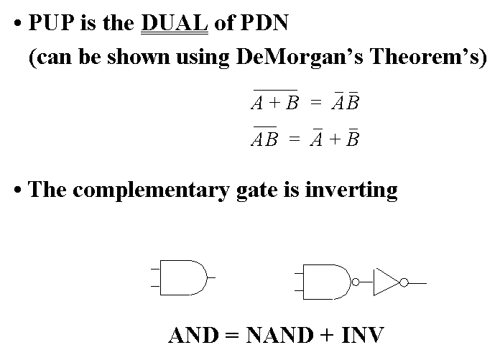
Complementary CMOS Logic Style
M.E.Zaghloul

Slide 11
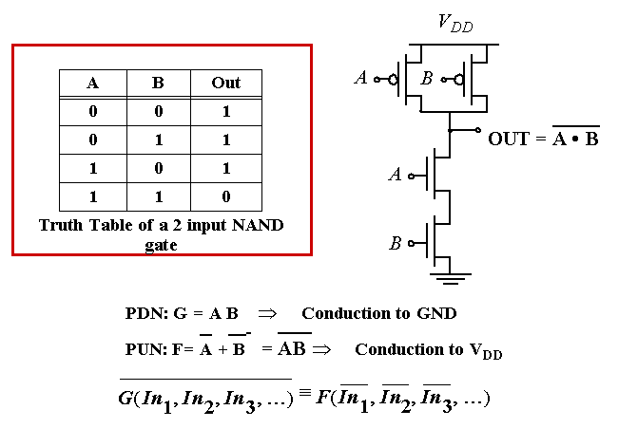
Example Gate: NAND
M.E.Zaghloul

Slide 12
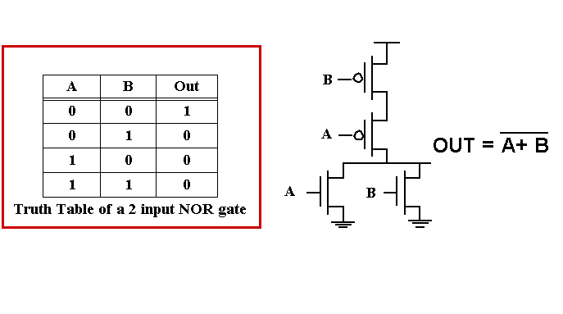
Example Gate: NOR
M.E.Zaghloul

Slide 13
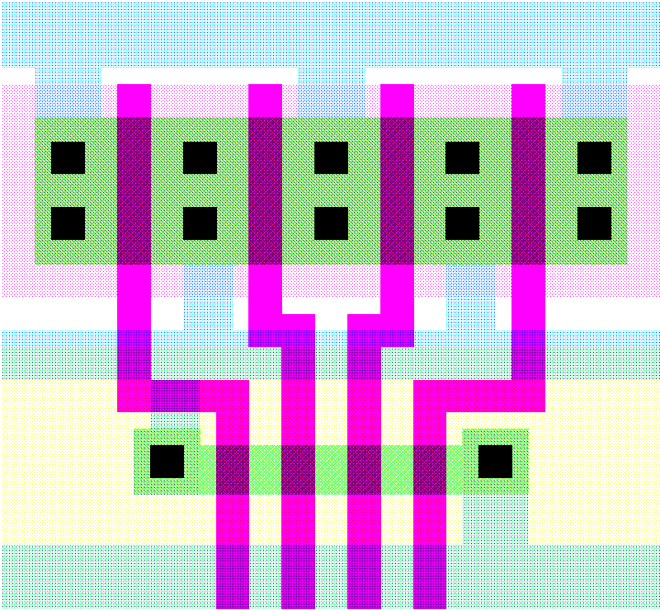
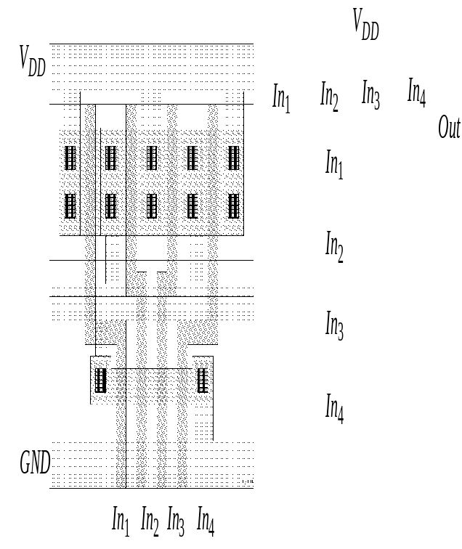
4-input NAND Gate
Vdd
Out
GND
In1
In2
In3
In4
M.E.Zaghloul

Slide 14
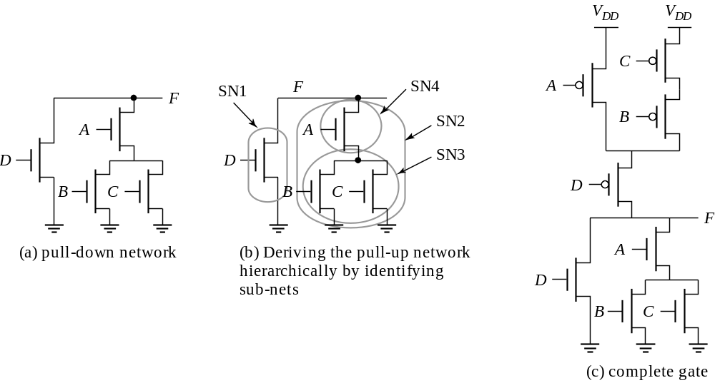
Constructing a Complex Gate
F = D+ A. (B+C)
M.E.Zaghloul

Slide 15
Cell Design
Standard Cells
  General purpose logic
  Can be synthesized
  Same height, varying width
Datapath Cells
  For regular, structured designs (arithmetic)
  Includes some wiring in the cell
  Fixed height and width
M.E.Zaghloul

Slide 16
Standard Cell Layout Methodology – 1990s
Mirrored Cell
No Routing
channels
V_{DD}
V_{DD}
M2
M3
GND
Mirrored Cell
GND
M.E.Zaghloul
Notes:
Contacts and wells not shown.
What does this implement??

Slide 17
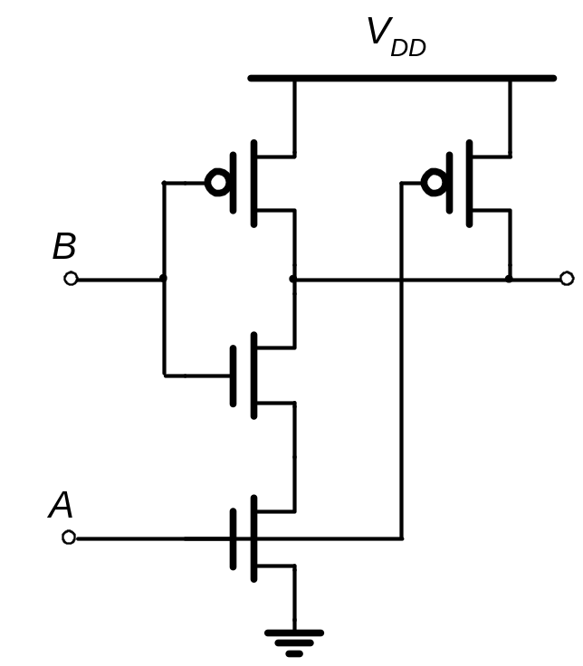
Standard Cells
V
2-input NAND gate
DD
A
B
Out
GND
M.E.Zaghloul

Slide 18
Stick Diagrams
Contains no dimensions
Represents relative positions of transistors
V
DD
V
DD
Inverter
NAND2
Out
Out
In
A
B
GND
GND
M.E.Zaghloul

Slide 19
How to Draw layout for Complex gate
People tried to use Graph theory to get optimal layout
Tried to minimize the area and the wiring
Note that PUN and PDN network are dual ( parallel becomes series )
Tries to identify vertices and nodes
M.E.Zaghloul

Slide 20
Stick Diagrams
Logic Graph
X
A
PUN
j
C
B
C
X
i
V_{DD}
X = C • (A + B)
C
i
B
j
A
A
B
PDN
A
GND
B
C
M.E.Zaghloul
Notes:
Systematic approach to derive order of input signal wires so gate can be laid out to minimize area
Note PUN and PDN are duals (parallel <-> series)
Vertices are nodes (signals) of circuit, VDD, X, GND and edges are transitions

Slide 21
Two Versions of C • (A + B)
A
C
B
A
B
C
V_{DD}
V_{DD}
X
X
GND
GND
M.E.Zaghloul
Notes:
Line of diffusion layout – abutting source-drain connections
Note crossover eliminated by A B C ordering

Slide 22
Consistent Euler Path
X
C
X
i
V_{DD}
B
j
A
GND
A
B
C
M.E.Zaghloul
Notes:
A path through all nodes in the graph such that each edge is visited once and only once.
The sequence of signals on the path is the signal ordering for the inputs.
PUN and PDN Euler paths are (must be) consistent (same sequence)
If you can define a Euler path then you can generate a layout with no diffusion breaks
A B C
C A B
B C A → no PDN
B A C
A C B -> no PDN
C B A

Slide 23
OAI22 Logic Graph
X
PUN
A
C
B
D
D
C
X
V_{DD}
X = (A+B)•(C+D)
C
D
B
A
A
B
PDN
A
GND
B
C
D
M.E.Zaghloul

Slide 24
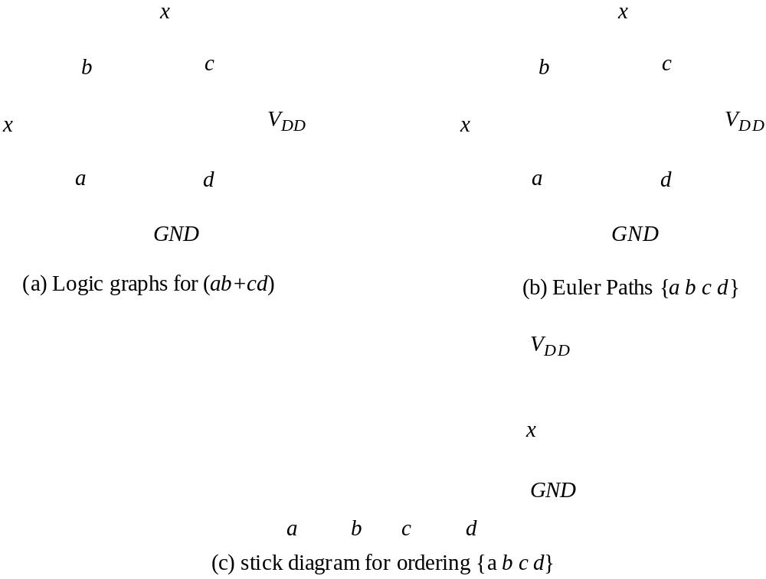
Example: x = ab+cd
M.E.Zaghloul

Slide 25
Multi-Fingered Transistors
One finger
Two fingers (folded)
Less diffusion capacitance
M.E.Zaghloul

Slide 26
CMOS Properties
Full rail-to-rail swing; high noise margins
Logic levels not dependent upon the relative device sizes; ratioless
Always a path to Vdd or Gnd in steady state; low output impedance
Extremely high input resistance; nearly zero steady-state input current
No direct path steady state between power and ground; no static power dissipation
Propagation delay function of load capacitance and resistance of transistors
M.E.Zaghloul

Slide 27
Properties of Complementary CMOS Gates Snapshot
High Noise Margins
V
and
V
are at
V
and
GND
, respectively.
OH
OL
DD
No static power consumption
:
There never exists a direct path between
V
and
DD
V
(
GND
) in steady-state mode
.
SS
Comparable rise and fall times:
(under appropriate sizing conditions)
M.E.Zaghloul

Slide 28
Propagation Delay in Static CMOS Gates
Similar to the delay calculations in inverter
Knowledge of calculation of capacitances intrinsic and extrinsic
It depends on the input pattern
M.E.Zaghloul

Slide 29
Input Pattern Effects on Delay
Delay is dependent on the pattern of inputs
Low to high transition
  both inputs go low
    delay is 0.69 R_{p}/2 C_{L}
  one input goes low
    delay is 0.69 R_{p} C_{L}
High to low transition
  both inputs go high
    delay is 0.69 2R_{n} C_{L}
R_{p}
R_{p}
A
B
R_{n}
C_{L}
B
R_{n}
C_{int}
A
M.E.Zaghloul

Slide 30
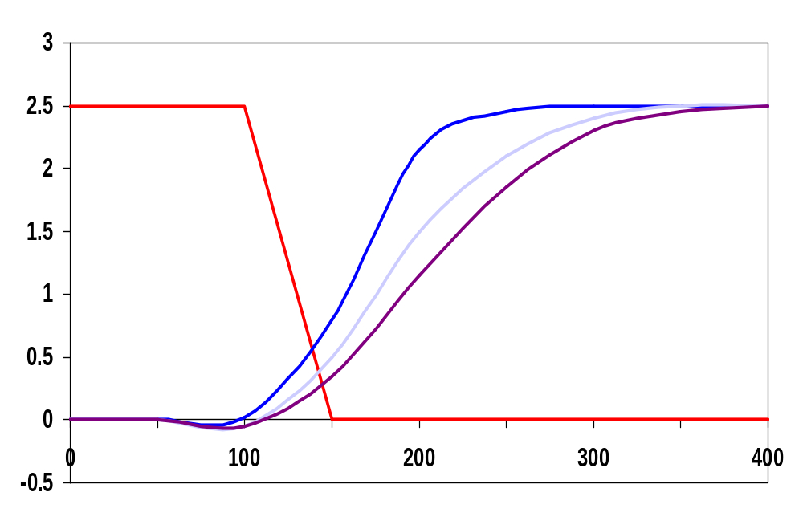
Delay Dependence on Input Patterns
Input Data Pattern | Delay (psec)
A=B=0--1 | 67
A=1, B=0--1 | 64
A= 0--1, B=1 | 61
A=B=1--0 | 45
A=1, B=1--0 | 80
A= 1--0, B=1 | 81
A=B=1--0
A=1 --0, B=1
Voltage [V]
A=1, B=1--0
time [ps]
NMOS = 0.5um/0.25 um
PMOS = 0.75um/0.25um
C_{L} = 100 fF
M.E.Zaghloul
Notes:
Gate sizing should result in approximately equal worst case rise and fall times.
Reason for difference in the last two delays is due to internal node capacitance of the pulldown stack. When A transitions, the pullup only has to charge CL; when A=1 and B transitions pullup have to charge up both CL and Cint.
For high to low transitions (first three cases) delay depends on state of internal node. Worst case happens when internal node is charged up to VDD – VTn.
Conclusions: Estimates of delay can be fairly complex – have to consider internal node capacitances and the data patterns.

Slide 31
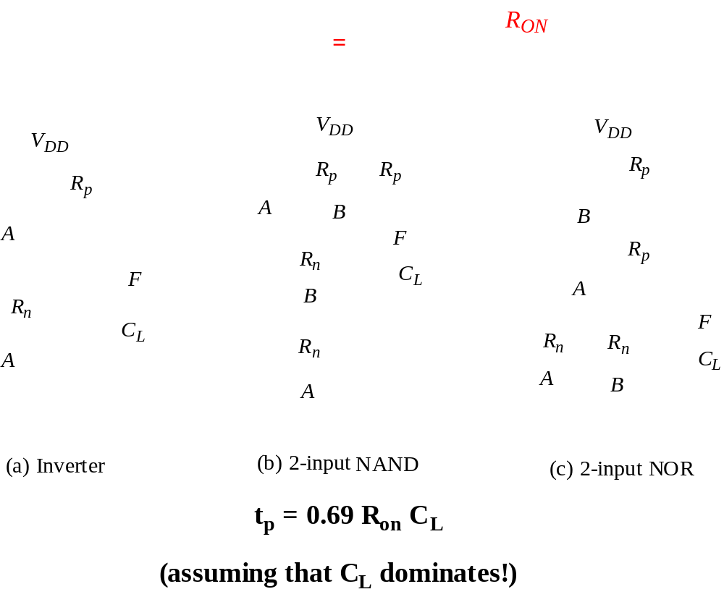
Propagation Delay Analysis - The Switch Model
M.E.Zaghloul

Slide 32
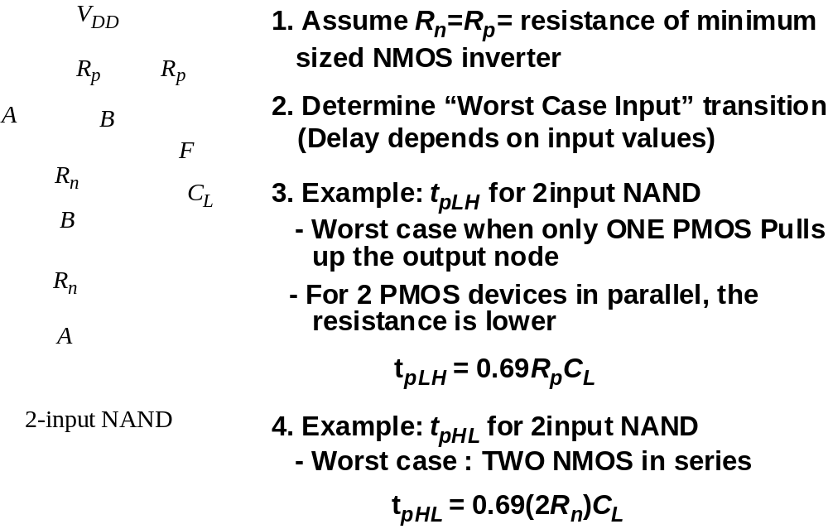
Analysis of Propagation Delay
M.E.Zaghloul

Slide 33
Fan-In Considerations
A
B
C
D
A
C_{L}
Distributed RC model
(Elmore delay)
t_{pHL} = 0.69 R_{eqn}(C₁+2C₂+3C₃+4C_{L})
Propagation delay deteriorates rapidly as a function of fan-in – quadratically in the worst case.
B
C₃
C
C₂
D
C₁
M.E.Zaghloul
Notes:
While output capacitance makes full swing transition (from VDD to 0), internal nodes only transition from VDD-VTn to GND
C1, C2, C3 on the order of 0.85 fF for W/L of 0.5/0.25 NMOS and 0.375/0.25 PMOS
CL of 3.2 fF with no output load (all diffusion capacitance – intrinsic capacitance of the gate itself).
To give a 80.3 psec tpHL (simulated as 86 psec)

Slide 34
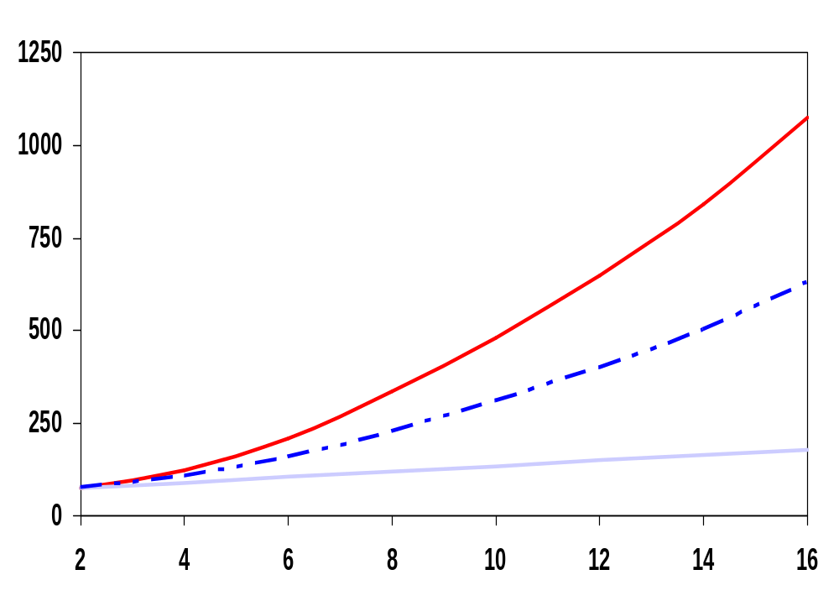
t_{p} as a Function of Fan-In
quadratic
Gates with a fan-in greater than 4 should be avoided.
t_{p} (psec)
t_{pHL}
tpLH
t_{pLH}
linear
fan-in
M.E.Zaghloul
Notes:
Fixed fan-out (NMOS 0.5 micrcon, PMOS 1.5 micron)
tpLH increases linearly due to the linearly increasing value of the diffusion capacitance
tpHL increase quadratically due to the simultaneous increase in pull-down resistance and internal capacitance

Slide 35
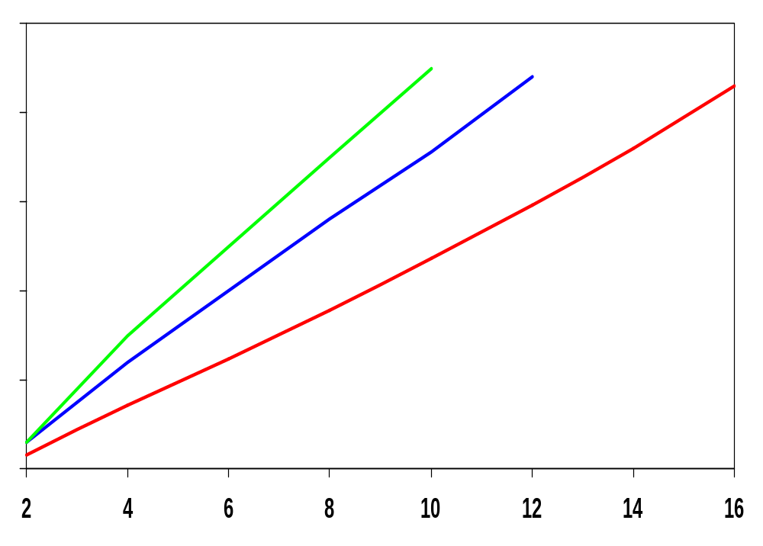
t_{p} as a Function of Fan-Out
All gates have the same drive current.
t_{p}NOR2
t_{p}NAND2
t_{p}INV
t_{p} (psec)
Slope is a function of “driving strength”
eff. fan-out
M.E.Zaghloul
Notes:
slope is a function of the driving strength

Slide 36
t_{p} as a Function of Fan-In and Fan-Out
Fan-in: quadratic due to increasing resistance and capacitance
Fan-out: each additional fan-out gate adds two gate capacitances to C_{L}
M.E.Zaghloul
Notes:
a1 term is for parallel chain, a2 term is for serial chain, a3 is fan-out

Slide 37
Design Techniques for Large Fan-in
Transistor sizing, reduce transistor resistance
Progressive Transistor Sizing for example R1 appears 4 –times in Elmore delay equation( 4-input NAND) M1 must have low resistance, M1 is the largest
Signal Ordering
Logic restructuring
M.E.Zaghloul

Slide 38
Fast Complex Gates:
Design Technique 1
Transistor sizing
  as long as fan-out capacitance dominates
Progressive sizing
Distributed RC line
M1 > M2 > M3 > … > MN
(the fet closest to the
output is the smallest)
In_{N}
MN
C_{L}
In₃
M3
C₃
In₂
M2
C₂
Can reduce delay by more than 20%; decreasing gains as technology shrinks
In₁
M1
C₁
M.E.Zaghloul
Notes:
M1 have to carry the discharge current from M2, M3, … MN and CL so make it the largest
MN only has to discharge the current from MN (no internal capacitances)

Slide 39
Fast Complex Gates:
Design Technique 2
Place the signal that arrive last near the output,in1 is the last signal. This will speed the gate
Transistor ordering
critical path
critical path
charged
0--1
charged
In₃
1
C_{L}
In₁
M3
C_{L}
M3
1
In₂
1
In₂
M2
C₂
charged
M2
C₂
discharged
In₃
1
discharged
In₁
M1
C₁
charged
M1
C₁
0--1
delay determined by time to discharge C_{L}, C₁ and C₂
delay determined by time to discharge C_{L}
M.E.Zaghloul
Notes:
For lecture.
Critical input is latest arriving signal
Place latest arriving signal (critical path) closest to the output

Slide 40
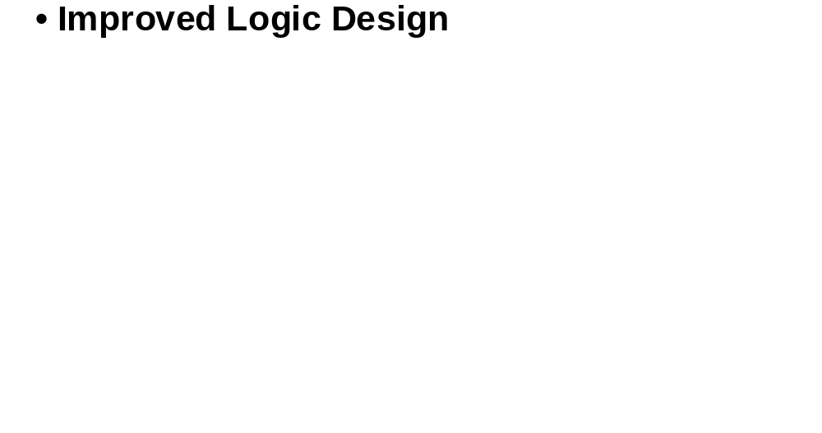
Fast Complex Gate - Design Techniques (3)
Reduce Fan-In by Logic restructuring
M.E.Zaghloul

Slide 41
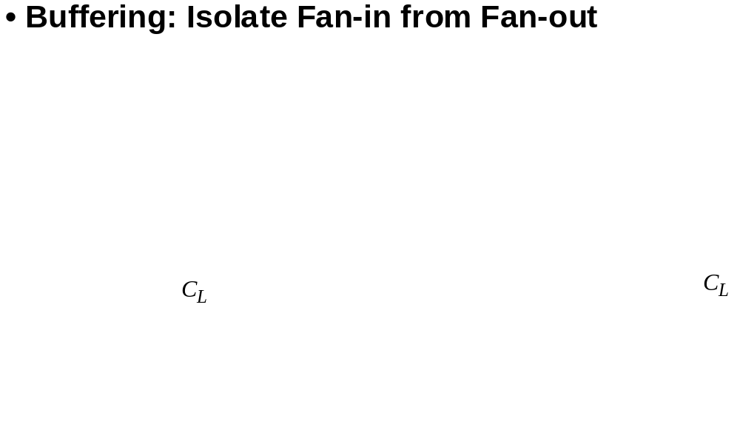
Fast Complex Gate - Design Techniques (4)
M.E.Zaghloul

Slide 42
Sizing Transistors to Optimize Delay
Delay formula as sum of parasitic and external loading
Time delay formula
t_{p} = t_{p0} (1 + C_{ext}/ ϒC_{g}) (inverter)
t_{p} = t_{p0} (1+ f/γ)
General Formula for delay (page 252)
t_{p} = t_{p0} (p+ gf/γ)
P depends on gate topology
g logical effort
M.E.Zaghloul

Slide 43
Optimization Performance in Combinational Circuits
It is based on Logic effort calculation for complex gates
The delay as expressed in linear equation sum of internal parasitic and output load
The techniques of inverter chain is used to predict the minimum delay in a path
We have not covered this part in this chapter pp251-263-please read this part in the text
M.E.Zaghloul

Slide 44
BREAK
M.E.Zaghloul

Slide 45
Review: Static Complementary CMOS
High noise margins
  V_{OH} and V_{OL} are at V_{DD} and GND, respectively
Low output impedance, high input impedance
No static power consumption
  Never a direct path between V_{DD} and GND in steady state
Delay a function of load capacitance and transistor on resistance
Comparable rise and fall times (under the appropriate relative transistor sizing conditions)
V_{DD}
In1
In2
…
PUN
InN
F(In1,In2,…InN)
In1
In2
…
PDN
InN
PUN and PDN are dual logic networks
M.E.Zaghloul
Notes:
One and only one of the networks (PUN or PDN) is conducting in steady state (output node is always a low-impedance node in steady state)
Why PUN of PMOSs only and PDN of NMOSs only ? (Next next slide)

Slide 46
Ratioed Logic
Instead of using 2-N transistors in each gate, try to reduce the number of transistors to N+1
This reason gives reason to introduce Ratioed logic style of design and also Dynamic CMOS design
M.E.Zaghloul

Slide 47
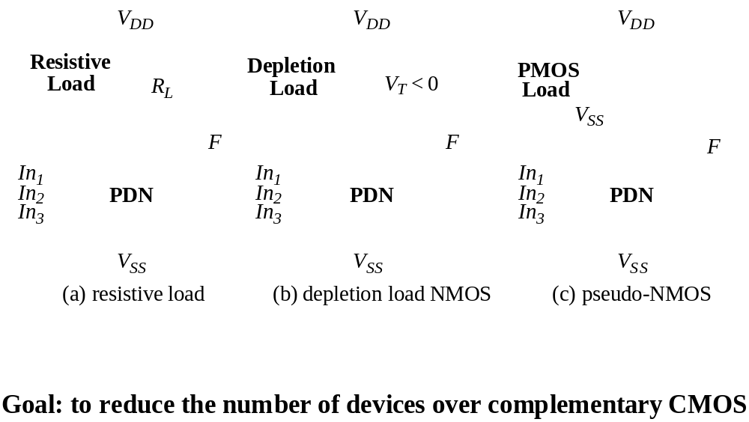
Ratioed Logic
M.E.Zaghloul

Slide 48
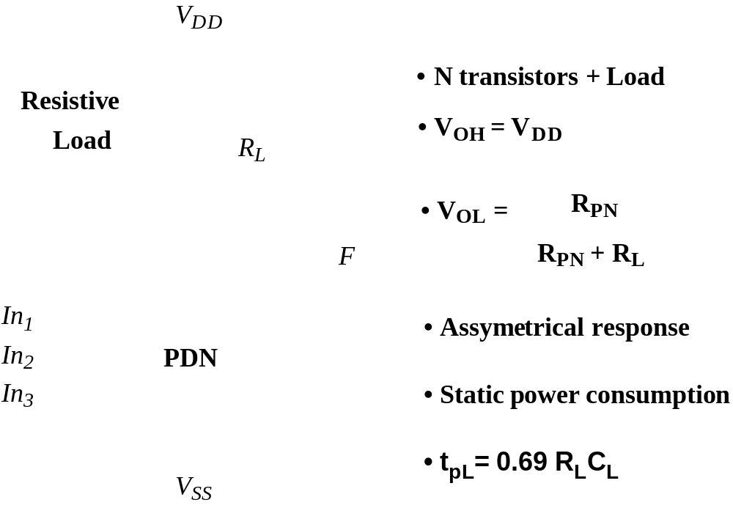
Ratioed Logic
M.E.Zaghloul

Slide 49
Ratioed Logic
The voltage swing on the output and the overall functionality of the gate depend on the ratio of the NMOS and PMOS sizes. The circuit is ratioed
M.E.Zaghloul

Slide 50
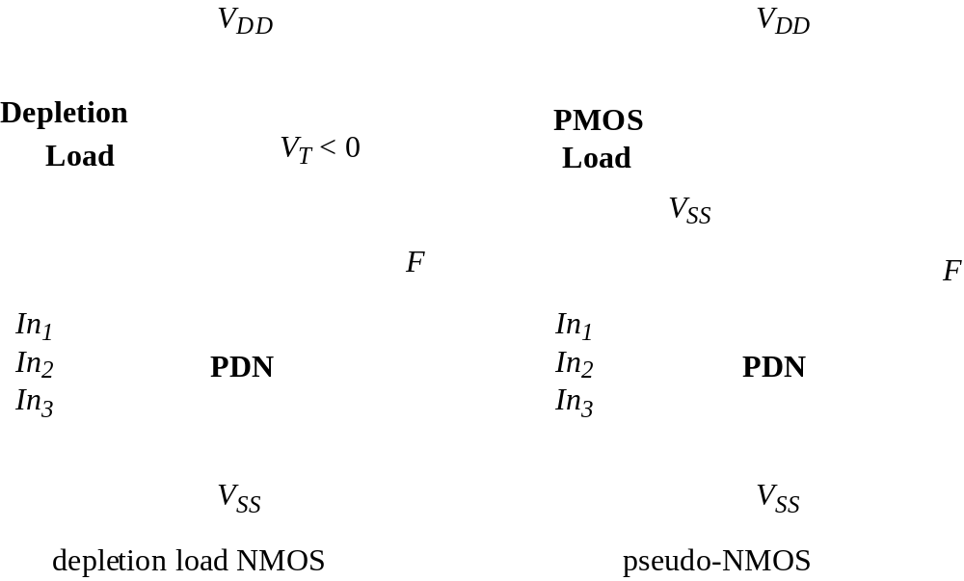
Active Loads
M.E.Zaghloul

Slide 51
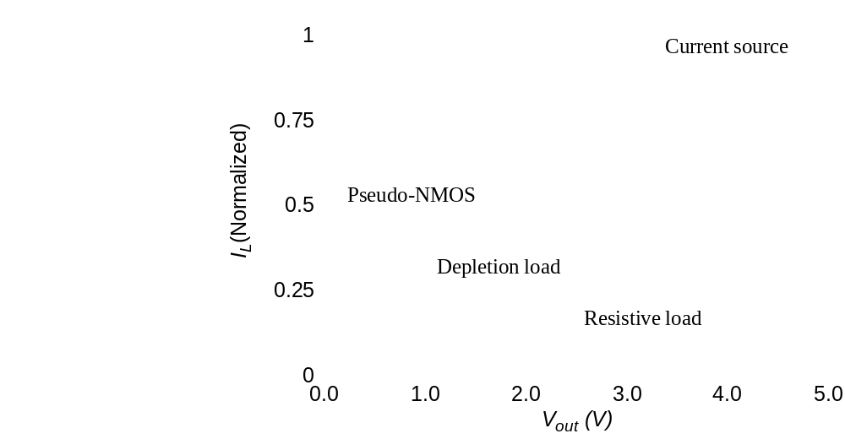
Load Lines of Ratioed Gates
M.E.Zaghloul

Slide 52
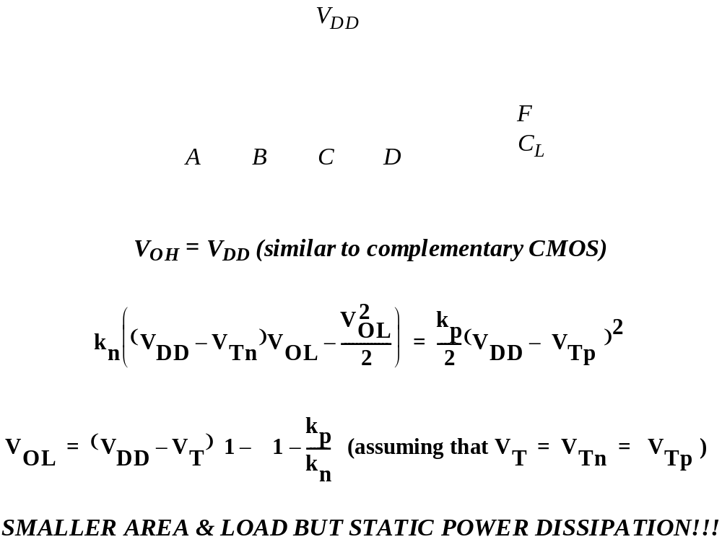
Pseudo-NMOS
M.E.Zaghloul

Slide 53
Static Power Dissipation
The static power dissipation limits the use of this design
This is used when area is the most important, because of the reduced transistor count compared with the complementary CMOS.
The following is another way to build better loads to eliminate static currents
M.E.Zaghloul

Slide 54
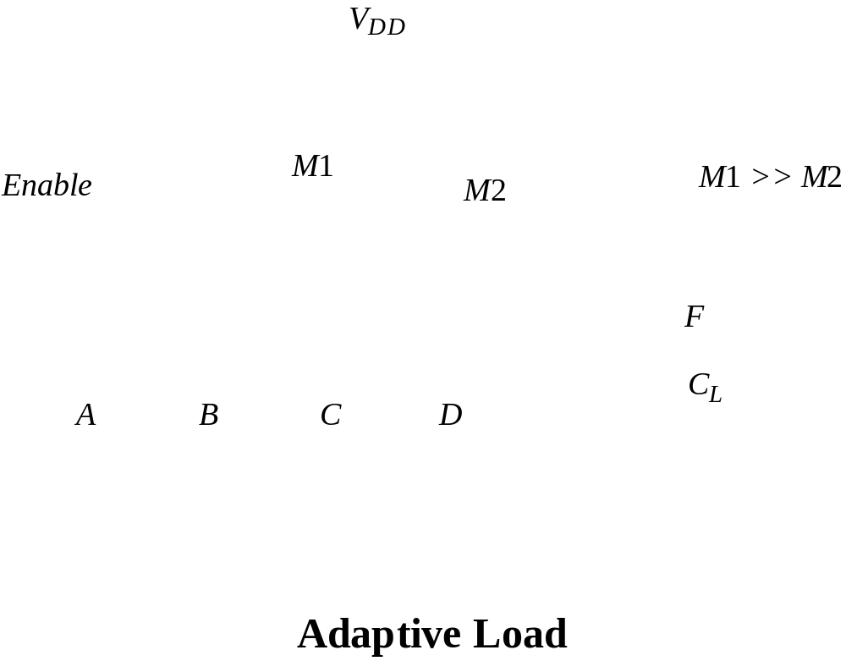
Improved Loads
Differential Cascode Voltage Switch Logic
Eliminates static currents and provides rail-to rail swing
M.E.Zaghloul

Slide 55
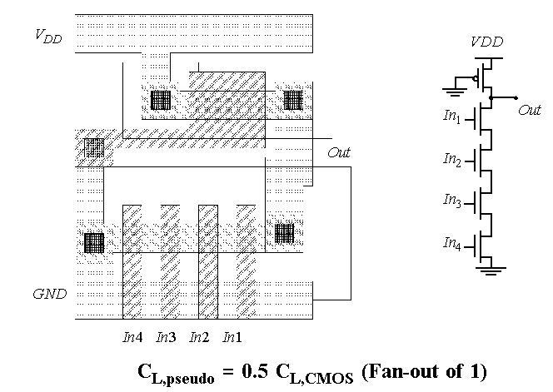
Example of Pseudo-NMOS NAND Gate
V_{DD}
GND
M.E.Zaghloul

Slide 56
Pass Transistor Logic Design
Popular transistor design, as alternative to complementary CMOS
It is called Pass Transistor Logic design
To reduce the number of transistors required
This will allow the input to derive gate as well as source and drain terminal
M.E.Zaghloul

Slide 57
Pass Transistor Logic
The goal is to reduce the number of transistors in the circuit
Use the device as switch to realize the Boolean function
M.E.Zaghloul

Slide 58
NMOS Transistors in Series/Parallel
Primary inputs drive both gate and source/drain terminals
NMOS switch closes when the gate input is high
Remember - NMOS transistors pass a strong 0 but a weak 1
A
B
X = Y if A and B
X
Y
A
B
X = Y if A or B
X
Y
M.E.Zaghloul

Slide 59
PMOS Transistors in Series/Parallel
Primary inputs drive both gate and source/drain terminals
PMOS switch closes when the gate input is low
Remember - PMOS transistors pass a strong 1 but a weak 0
A
B
X = Y if A and B = A + B
X
Y
A
B
X = Y if A or B = A . B
X
Y
M.E.Zaghloul

Slide 60
Pass Transistor (PT) Logic-
AND gate
B
B
A
A
F
B
B
0
F
0
F= AB
Gate is static – a low-impedance path exists to both supply rails under all circumstances
N transistors instead of 2N
No static power consumption
Ratioless
Bidirectional (versus undirectional)
M.E.Zaghloul
Notes:
For class handout

Slide 61
Notice
Pass transistors cannot be cascaded that is the output of a pass transistor is the input of another pass transistor
Output only charge to V_{DD} - V_{Th}
M.E.Zaghloul

Slide 62
Cascaded NMOS Only PTs
B = V_{DD}
B = V_{DD}
C = V_{DD}
G
x
y
A = V_{DD}
M₁
M₂
Out
A = V_{DD}
M₁
x = V_{DD} - V_{Tn1}
S
G
y
Out
C = V_{DD}
M₂
S
Swing on y = V_{DD} - V_{Tn1} - V_{Tn2}
Swing on y = V_{DD} - V_{Tn1}
Pass transistor gates should never be cascaded as on the left
Logic on the right suffers from static power dissipation and reduced noise margins
M.E.Zaghloul
Notes:
what if C (on right) is VDD-Vtn?

Slide 63
VTC of PT AND Gate
(Voltage Transfer Curve of Pass Transistor
B
B=V_{DD} , and A =0--V_{DD} the top transistor is ON while the bottom is off ,the output just follow the input A until the input reach V_{DD}-Vth
Next Consider A = V_{DD} and B=0--V_{DD}
Next Consider A = V_{DD} and B=0—V_{DD}
The bottom transistor is ON, the output close 0. until the bottom transistor is turned off
Please see the curve page 271
1.5/0.25
0.5/0.25
A
0.5/0.25
B
F
= AB
0
0.5/0.25
Pure PT logic is not regenerative - the signal gradually degrades after passing through a number of PTs (can fix with static CMOS inverter insertion)
M.E.Zaghloul
Notes:
VTC is data dependent
For blue case – top pass transistor on, bottom off, output follows input A until input is high enough to turn off the top pass transistors (Vdd-Vtn or 2.1 volts in example)
For red case, bottom transistor stays on until the inverter switches to zero (at ~ VDD/2 or 1.25 V). Once the bottom pass transistor turns off, the output follows B minus VTn
Observe that a pure PT gate is not REGENERATIVE. A gradual signal degradation will be observed after passing through a number of subsequent states. Can be remedied by the occasional insertion of a CMOS inverter.

Slide 64
NMOS Only PT Driving an Inverter
In = V_{DD}
V_{x} = V_{DD}-V_{Tn}
V_{GS}
M₂
A = V_{DD}
D
S
B
M₁
V_{x} does not pull up to V_{DD}, but V_{DD} – V_{Tn}
Threshold voltage drop causes static power consumption (M₂ may be weakly conducting forming a path from V_{DD} to GND)
Notice V_{Tn} increases of pass transistor due to body effect (V_{SB})
M.E.Zaghloul
Notes:
situation is worsened by the body effect since there is SIGNIFICANT source to body voltage when pulling high since the body is tied to GND and the source charges up to VDD

Slide 65
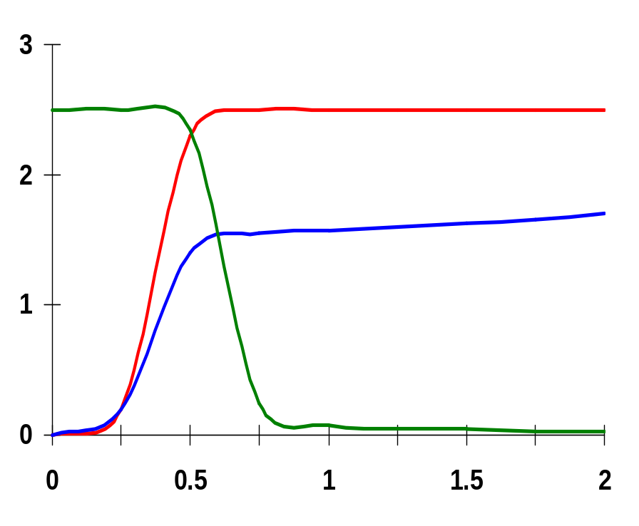
(PP 270)Voltage Swing of PT Driving an Inverter
In
In = 0 -- V_{DD}
1.5/0.25
x = 1.8V
D
S
x
V_{DD}
Out
Voltage, V
0.5/0.25
B
0.5/0.25
Out
Time, ns
Body effect – large V_{SB} at x - when pulling high (B is tied to GND and S charged up close to V_{DD})
So the voltage drop is even worse
V_{x} = V_{DD} - (V_{Tn0} + γ(√(|2φ_{f}| + V_{x}) - √|2φ_{f}|))
M.E.Zaghloul
Notes:
situation is worsened by the body effect since there is significant source to body voltage when pulling high since the body is tied to GND and the source charges up to VDD

Slide 66
Differential Pass Transistor Logic
For high performance Differential Pass transistor logic family is usually used
Basic idea is to use true and complementary inputs to produce true and complementary outputs
The following is design of several gates
M.E.Zaghloul

Slide 67
Differential PT Logic (CPL)-P272
A
A
PT Network
B
F
F
B
A
A
Inverse PT Network
F
B
F
B
B
B
B
B
B
B
A
A
A
F=AB
B
F=A+B
A
F=AXORB
B
A
A
A
F=AB
F=A+B
F=AxorB
B
B
A
AND/NAND
OR/NOR
XOR/XNOR
M.E.Zaghloul
Notes:
Question for class - Why not do the same with all pfets??

Slide 68
CPL Properties
Complementary Pass Transistor Logic
Differential so complementary data inputs and outputs are always available (so don’t need extra inverters)
Still static, since the output defining nodes are always tied to V_{DD} or GND through a low resistance path
Design is modular; all gates use the same topology, only the inputs are permuted.
Simple XOR makes it attractive for structures like adders
Fast (assuming number of transistors in series is small)
Additional routing overhead for complementary signals
Still have static power dissipation problems
M.E.Zaghloul

Slide 69
CPL Full Adder
B
B
C_{in}
C_{in}
A
!Sum
A
Sum
B
B
C_{in}
C_{in}
A
!C_{out}
B
C_{in}
A
C_{out}
B
C_{in}
M.E.Zaghloul
Notes:
For class handout

Slide 70
CPL Full Adder
B
B
C_{in}
C_{in}
A
!Sum
A
Sum
B
B
C_{in}
C_{in}
A
!C_{out}
B
C_{in}
A
C_{out}
B
C_{in}
M.E.Zaghloul
Notes:
20 + 4*2 = 28 transistors
color coded with CPL logic slide
problems with (more than one) threshold drops due to chaining CPL blocks

Slide 71
Level Restoring Circuit-p274
Differential pass transistor suffers from static power dissipation and reduced noise margins
Restorer is used to speed and power impacts: increases the capacitance at x, slowing down the gate; increases t_{r} (but decreases t_{f})
M.E.Zaghloul

Slide 72
Solution 1: Level Restorer P274
M_{r}
Level Restorer
B
off
on
M₂
x
= 0
A=0
M_{n}
Out
=1
A=1
Out=0
M₁
1
Full swing on x (due to Level Restorer) so no static power consumption by inverter
No static backward current path through Level Restorer and PT since Restorer is only active when A is high
For correct operation M_{r} must be sized correctly (ratioed)
M.E.Zaghloul
Notes:
What is it doing while B is zero?
if x was zero (CL discharged), Out stays at 1 through M1 - stable
if x was 1 (CL charged), Out stays at 0 through M2 and holds Mr on keeping CL charged - stable!
Why ratioed – when node x is going from high to low the pull-down network through Mn must be stronger than the pull-up network of Mr in order to switch node x. When Rr is too small, it is impossible to bring the voltage at node x below the switching threshold of the inverter (a function of R1 and R2).

Slide 73
Solution 2: Multiple V_{T} Transistors P272
Technology solution: Use (near) zero V_{T} devices for the NMOS PTs to eliminate most of the threshold drop (body effect still in force preventing full swing to V_{DD})
low V_{T} transistors
In₂ = 0V
A = 2.5V
on
Out
off but leaking
In₁ = 2.5V
B = 0V
sneak path
Impacts static power consumption due to subthreshold currents flowing through the PTs (even if V_{GS} is below V_{T})
M.E.Zaghloul

Slide 74
Solution 3: Use of Transmission Gates (TGs)-page 279
Most widely used solution
C
C
A
B
A
B
C
C
C = GND
C = GND
A = V_{DD}
B
A = GND
B
C = V_{DD}
C = V_{DD}
Full swing bidirectional switch controlled by the gate signal C, A = B if C = 1
M.E.Zaghloul
Notes:
Use the NOMS to pull down and the PMOS to pull up
Sizing - use all minimum size, increasing W/L has no net impact on switching delay (reduces resistance but increases diffusion capacitance)
Also ratioless logic

Slide 75
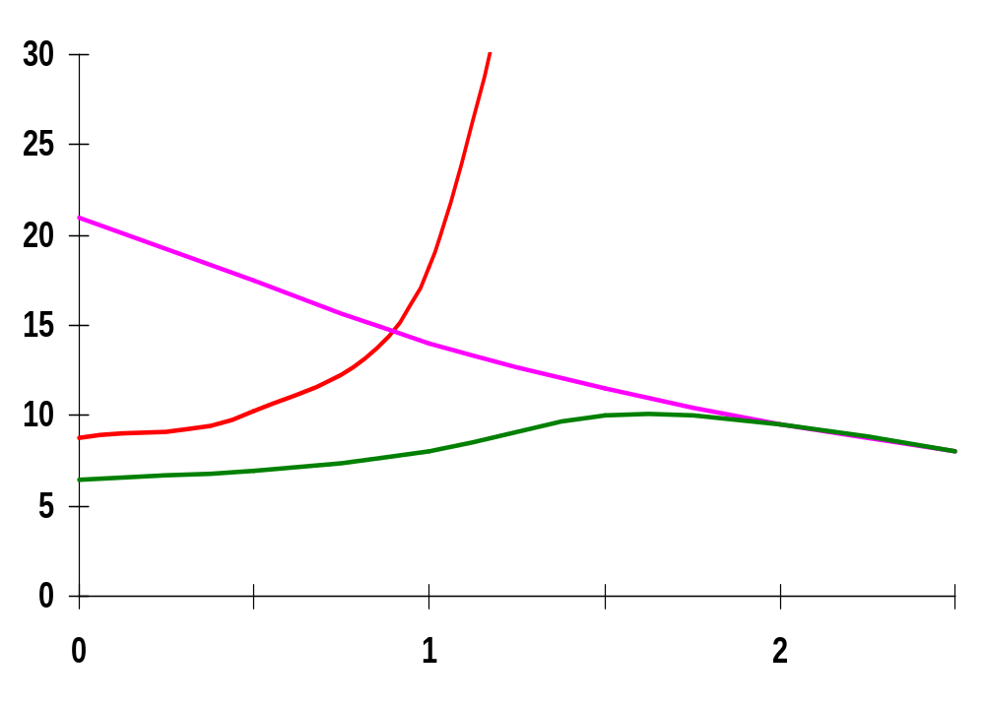
Resistance of TG
Performance of TG-page 281
W/L_{p}=0.50/0.25
0V
R_{n}
R_{p}
2.5V
V_{out}
R_{p}
R_{n}
Resistance, kΩ
2.5V
R_{eq}
W/L_{n}=0.50/0.25
V_{out}, V
Simulations results
M.E.Zaghloul
Notes:
Transmission gate is not an ideal switch - series resistance
Effective resistance modeled as parallel connection of Rp and Rn (Rp = (VDD - Vout)/Ip)
For Rn, low values of Vout, in saturation; as Vout increases, resistance increases to infinity (as device shuts off)
For Rp, low values of Vout, in saturation; as Vout approached Vdd, linear mode so resistance decreases.
Req = Rp || Rn is relatively constant ( about 8kohms in this case), so can assume has a constant resistance

Slide 76
2X1 TG Multiplexer
6-transistors
S
S
F
S
V_{DD}
In₂
S
F
In₁
S
F (bar) = (In₁ . S + In₂ . S(bar) )
GND
In₁
S
S
In₂
M.E.Zaghloul
Notes:
How does this compare to a static complementary multiplexer (4t in pull down, 4t in pull up), so 2 fewer transistors.
Smaller - probably
Faster?
Cooler?

Slide 77
Transmission Gate XOR
B=0,output = A
B=1,output= A(bar)
A
A xor B
B
X is node of contact
M.E.Zaghloul
Notes:
For class handout
6 transistor implementation of XOR (versus 10t or 12t for static complementary CMOS)

Slide 78
Transmission Gate XOR
weak 0 if !A
off
on
A • !B
A
A ⊕ B
If B=0 Pass A
If B =1
Pass Ab
off
on
B • !A
weak 1 if A
0
B
an inverter if B=1
1
Only SIX transistors
M.E.Zaghloul
Notes:
6 transistor implementation of XOR (versus 10t or 12t for static complementary CMOS)
Note - F always has a connection to VDD or GND, not dynamic so no need to refresh
No voltage drop - obvious with green, for red use transmission gate to ensure no drop

Slide 79
TG Full Adder using XOR
C_{in}
B
A
Sum
C_{out}
M.E.Zaghloul
Notes:
16 transistors – vesterbacke in SiPS99
no more than 2 PT in series, max
full swing - tranmission gates

Slide 80
Differential TG Logic (DPL)
B
A
B
A
B
A
B
A
A
A
F=AB
B
F=A⊕B
GND
B
A
B
GND
V_{DD}
A
A
F=AB
B
F=A⊕B
V_{DD}
A
B
B
AND/NAND
XOR/XNOR
M.E.Zaghloul

Slide 81
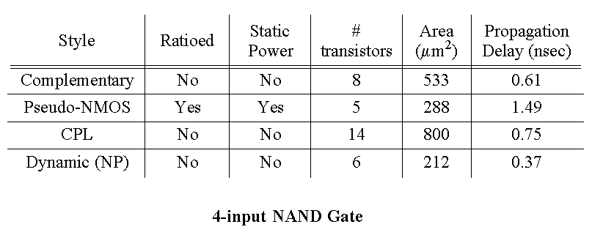
CMOS Circuit Styles - Summary
M.E.Zaghloul

Slide 82
Next Week Dynamic Logic
M.E.Zaghloul

